Slide 1
GYM MANAGEMENT SYSTEM

Slide 2
ABSTRACT
This project “Gym Management System” is solution fitness centers to manage the customers in an easier and more convenient way. The administrator, is able to view all the members of fitness center as well as their details. This project is a computer-based program and it manages the gym members, the personnel and the inventory. This system also maintains the client details, to provide the valuable reports of the work out time calculations. Also maintain the gym members in and out details it will automatically calculate the member workout timings. Also, administrator can find out the renewal date also, which is maintain very hard to handle manually. This system also has to display the material details and the quanity.

Slide 3
HARDWARE SPECFICATION
Processor : P 4 700 GHz.
RAM : 4 GB RAM
Hard Disk Drive : 180 GB

Slide 4
SOFTWARE SPECIFICATION
Operating System : Windows 7/8/10
Front End : JAVA
Back End : SQL

Slide 5
EXISTING SYSTEM
The gym is working manually. The current system is time consuming and also it is very costly, because it involves a lot of paperwork. To manually handle the system was very difficult task. But now-a-days computerization made easy to work.
Disadvantages
The following are the reasons why the current system should be computerized:
To increase efficiency with reduced cost.
To reduce the burden of paper work
To save time management for recording details of each and every member and employee.
To generate required reports easily

Slide 6
PROPOSED SYSTEM
This Gym Management System tool is basically developed to aid the user to add a member to the gym. The user shall be able to add the name, date of birth and contact address of the member. It also records the phone numbers and the height and weight data of the member. It shall have the admission date. It also has an option to check whether the member is new or an existing one. It stores the photo of the member. It shall help the user to know about fee payments. It has the option to select type of fee payments. It could be monthly, quarterly or annually depending on the choice of the member. It also holds the receipt number and the amount of fees paid. It shall also generate reports based on the payment of fees. It shall also enable the user to update information of members. This tool uses .net framework with MS Access as the database. It secures the data of each user. Storage and retrieval of data is fast through these .net tools System
Advantages
It provides wide range of certain criteria in each window the client is working for better and quicker solution.
It maintains report for all criteria and transactions.
Manages member information separately for all exercise and employee information separately for considering the requirements of gym.
Stores information about regular products.
This system can run on any windows operating system

Slide 7
Modules
Member Registration
IN/OUT Entry Details
GYM Materials
Service Entries
Health tip
Member Registration:
This module will be used to perform get the data about the gym members. This detail will be stored in a database. When the gym owner needs an details for the members it will takes from the member table.

Slide 8
I/OUT Entry:
This module has been collecting the in time and out time information for the members. This will give and entire report about the members. We can easy to track the working hours for the members.
GYM Material
This module will used to store the information about the gym material, which can collect all the information and store into the material table.

Slide 9
Service Entries
This module will store the information for the services issues, gym owner any time can check the services in the service table.
Health Tips
This contains collect the information regarding the health tips, the gym workers easily to find out the tips and helps to the workers.

Slide 10

Data Flow Diagram
Level 0:

Slide 11
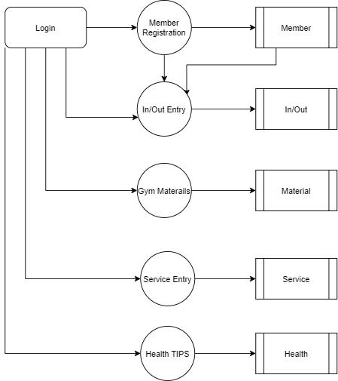
Level 1:

Slide 12
TABLE DESIGN TABLE NAME:EMPLOYEE
FIELD | DATA TYPE | SIZE | CONSTRAINT
employee id | Int | 10 | Primary key
First name | Varchar | 20 | Not null
Last name | Varchar | 10 | Not null
Mobile | Int | 10 | Not null
Email | Varchar | 20 | Not null
Age | Int | 10 | Not null
Gender | Varchar | 5 | Not null
Address | Varchar | 30 | Not null

Slide 13
TABLE NAME:MEMBER
FIELD | DATA TYPE | SIZE | CONSTRAINT
Member id | Int | 10 | Primary key
First name | Varchar | 20 | Not null
Last name | Varchar | 10 | Not null
Mobile | Int | 10 | Not null
Email | Varchar | 20 | Not null
Age | Int | 10 | Not null
Gender | Varchar | 5 | Not null
Height | Int | 5 | Not null
Weight | Int | 5 | Not null
Address | Varchar | 30 | Not null

Slide 14
TABLE NAME:INOUT/OUTPUT
FIELD | DATA TYPE | SIZE | CONSTRAINT
In out id | Int | 10 | Primary key
Member id | Int | 10 | Foreign key
Punch in | Date | 10 | Not null
Punch out | Date | 10 | Not null
date | Date | 10 | Not null

Slide 15
TABLE NAME:MATERIAL
FIELD | DATA TYPE | SIZE | CONSTRAINT
Material id | Int | 10 | Primary key
Material name | Varchar | 30 | Not null
Quantity | Int | 6 | Not null
amount | Int | 5 | Not null

Slide 16
TABLE NAME:SERVICE
FIELD | DATA TYPE | SIZE | CONSTRAINT
Service id | Int | 10 | Primary key
Material name | Varchar | 20 | Not null
Provider | Varchar | 20 | Not null
Amount | Int | 5 | Not null
Issue | Varchar | 30 | Not null
date | Date | 10 | Not null

Slide 17
TABLE NAME:ADMIN
FIELD | DATA TYPE | SIZE | CONSTRAINT
admin id | Int | 10 | Primary key
Admin name | Varchar | 20 | Not null
Admin mobile | Int | 10 | Not null
Username | Varchar | 20 | Not null
Password | Varchar | 20 | Not null
address | Varchar | 30 | Not null

Slide 18
TABLE NAME:HEALTH
FIELD | DATA TYPE | SIZE | CONSTRAINT
Health id | Int | 10 | Primary key
Health title | Varchar | 20 | Not null
Description | Varchar | 30 | Not null
date | Date | 10 | Not null

Slide 19
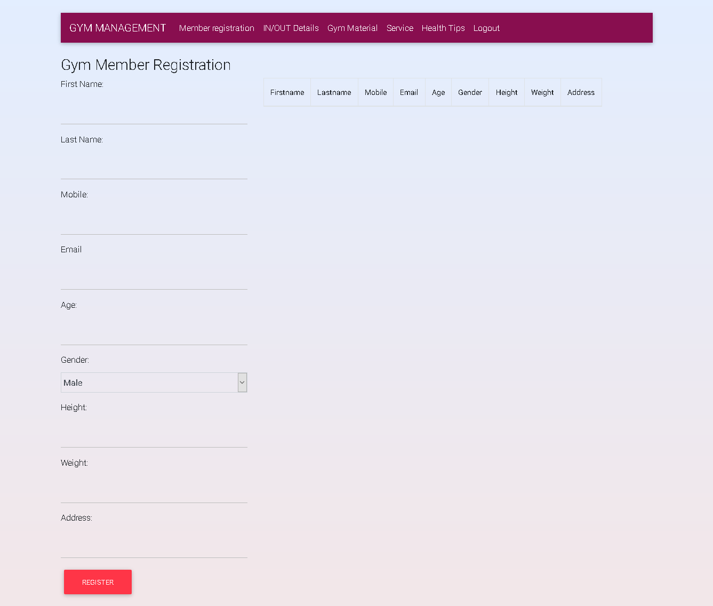

Slide 20
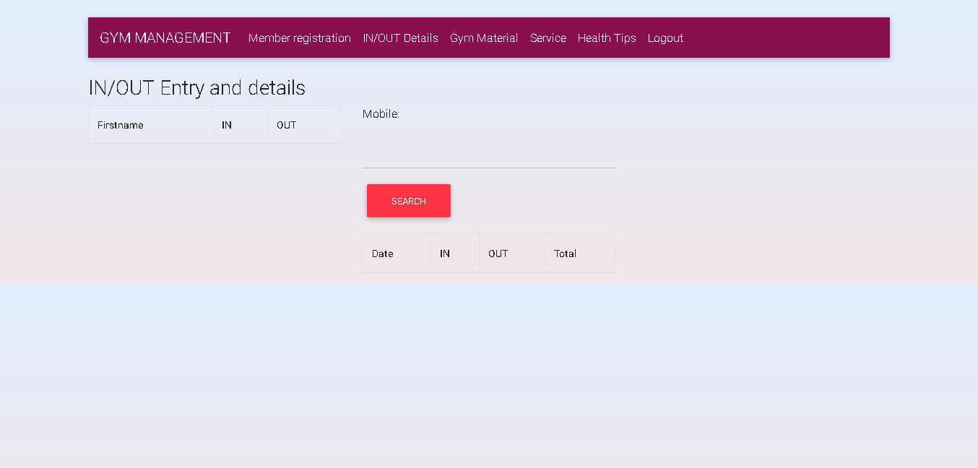

Slide 21
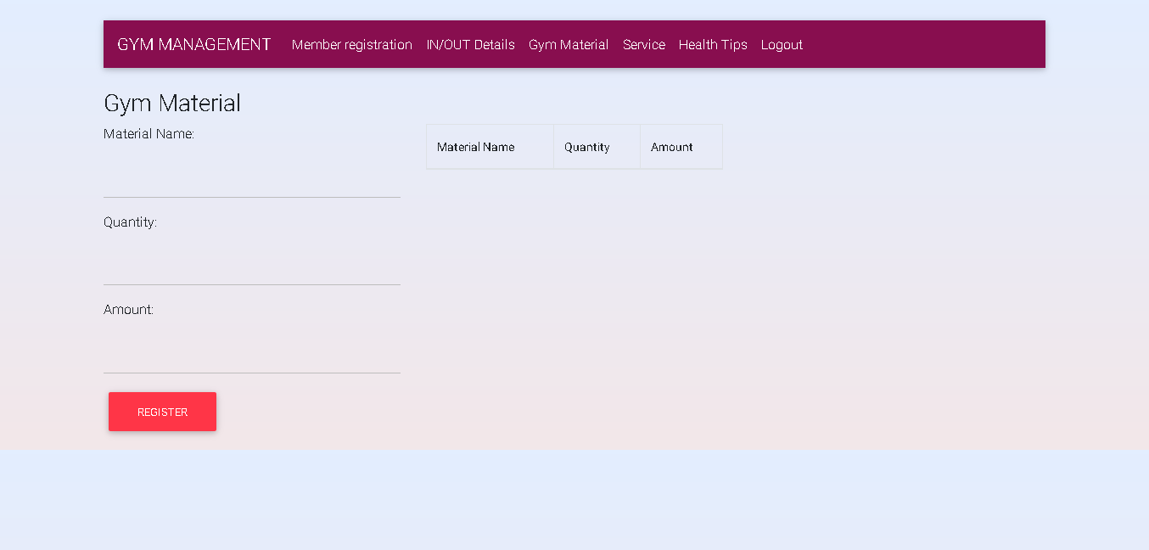

Slide 22
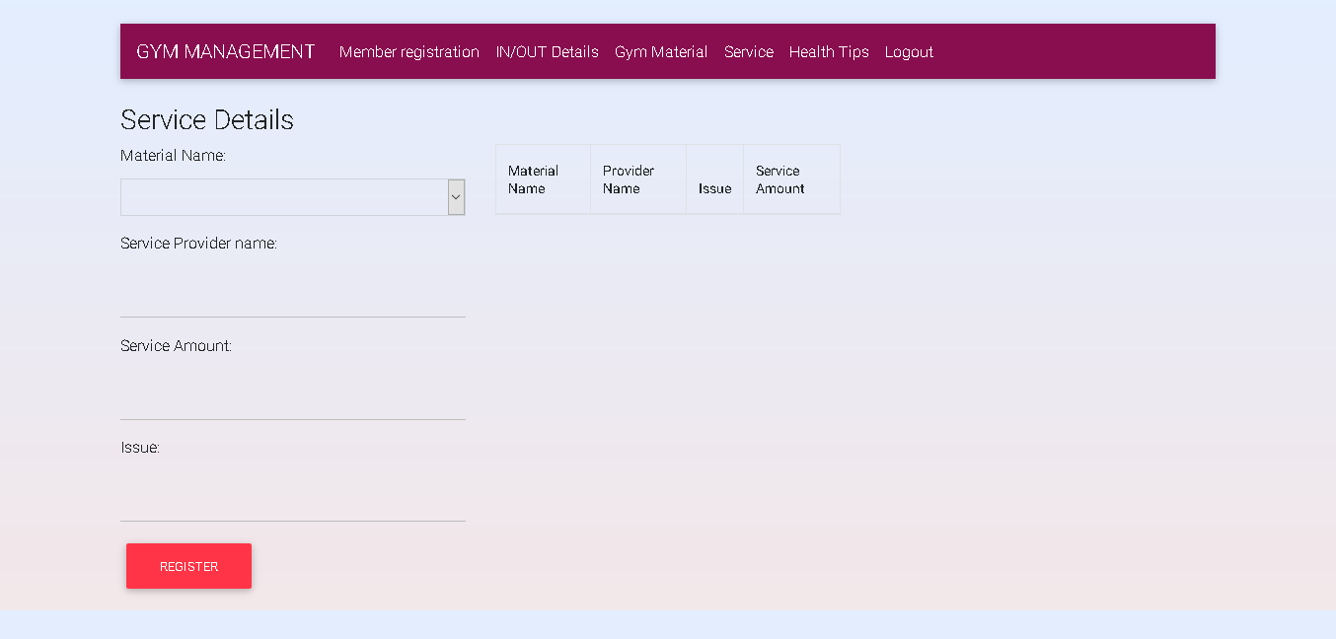

Slide 23
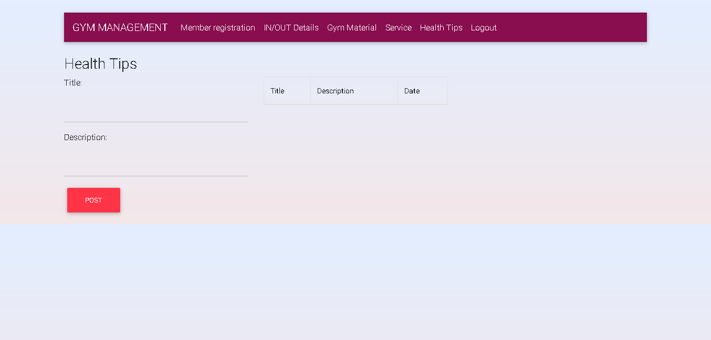

Slide 24
Thank You

